Slide 1

Project Jedi A cloud of controversy
JEDI JEDI
JEDI JEDI
JEDI JEDI JEDI JEDI JEDI
JEDI JEDI
JEDI JEDI
Group1
YA-Jwu Jang, Alan Daniel Wilson,
Mohana Dutta, Saikumar Eddandi
Photo: iStock
Notes:
https://www.nationaldefensemagazine.org/articles/2021/7/6/pentagon-cancels-jedi-program-launches-new-cloud-computing-effort

Slide 2

AGENDA
What is jedi project?
Why is important?
Issues raised by the project
Should the contract be awarded to a single vendor?
What is the state of the contract and what is next?
AGENDA
AGENDA
matejmo/Getty Images
Notes:
https://www.c4isrnet.com/opinion/2019/03/21/the-pentagons-jedi-cloud-strategy-is-ambitious-but-can-it-work/

Slide 3
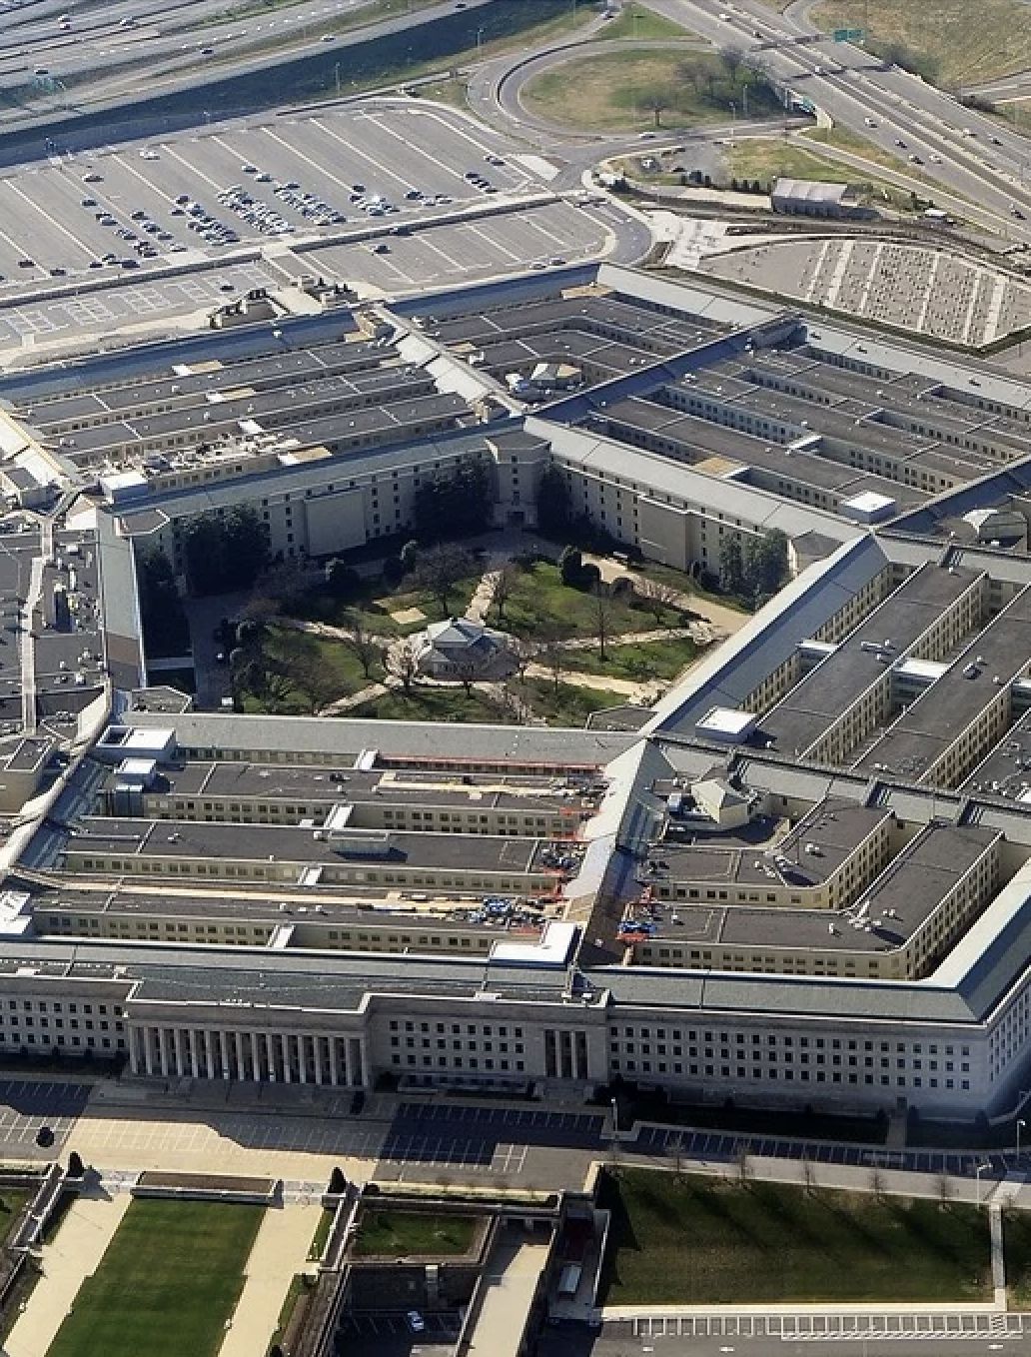
INTRODUCTION
INTRODUCTION
INTRODUCTION
Project JEDI (Joint Enterprise Defense Infrastructure) is the United States Department of Defense’s plan to integrate the Department and bring new-age Digital technology specially Cloud computing to the department. Its stated goals are to accelerate information and analysis sharing with combat forces and replace branch-oriented systems with faster enterprise systems.
the headquarters of the United States Department of Defense,2019

Slide 4


Why is it so important? What problems was it meant to solve?
Importance
Problems meant to solve
High speed with instant access to large quantity data for enterprises
Supports global operations
Enhances decision-making as it is informed
Old models of manufacturing (1980-1990)
Complex, fragmented services
Need for unified cloud
Notes:
https://conestoga-bookshelf.vitalsource.com/reader/books/9780136971627/epubcfi/6/338[%3Bvnd.vst.idref%3DP7001017387000000000000000001DAC]!/4/2[P7001017387000000000000000001DAC]/2/2[P7001017387000000000000000001DAD]/1:35[rat%2Cing] para 1-15

Slide 5



What management, organization, and technology issues are raised by this project?
Management issues
Organization issues
Technology issues
Vendor selection process
Risk of dependent on one vendor
Inter-agency coordination
Data governance and compliance
Internal resistance and skill gaps
Security and privacy issues
Scalability and reliability
Integrating modern cloud systems
Artificial intelligence and advanced technology

Slide 6

Single vs multi-vendor
Single vs multi-vendor
Single vs multi-vendor
Single Vendor advantages
Multi-vendor
benefits
Reduced complexity
Streamlined communication
Unified security standards
Clear accountability
Industry best practice (80% use multiple vendors)
Enhance security via redundancy
Lower vendor lock-in-risk
Competitive innovation

Slide 7


Analysis
Align with commercial best practice
Stronger risk management
Flexibility for future needs
Sustains innovation
analysis
analysis
Notes:
https://www.meritalk.com/articles/disa-official-says-failure-mindset-changing-following-jedi/

Slide 8

Current & future status
PERSONAL
TRAINING
PERSONAL
TRAINING
PERSONAL
TRAINING
PERSONAL
Current status
JEDI contract was cancelled (July 2021)
Replaced by JWCC
$9B contract awarded (Dec 2022)
Future direction
Multi-vendor: Amazon, Microsoft, Google, Oracle
Focus on flexibility and innovation
Implementation through 2028
THE CLOUD, AREK
Notes:
https://www.federaltimes.com/civilian/dhs/2020/04/15/pentagon-ig-finds-jedi-contract-didnt-violate-law-but-ethical-questions-remain/

Slide 9
REFERENCES
Laudon, K. C., & Laudon, J. P. (2021). Management Information Systems: Managing the Digital Firm (17th ed.). Pearson Education (US). https://conestoga-bookshelf.vitalsource.com/books/9780136971627

Slide 10

THANK YOU
THANK
YOU
THANK
YOU
THANK
YOU
THANK
ISTOCK

